Slide 1
AHEAD Innovation Days
AWS – Automation, Security, and Governance
WIFI – On Whiteboard on the right
Notes:
Good morning.
Thanks for the opportunity to introduce you to our company – AHEAD.
If okay with you, I’d like to take this approach.
I know you get a lot of sales pitches. I’m guessing most of them start with a vendor or consultant talking about -- themselves, about what they do, and what sets them apart.

Slide 2

These Are Complex Balancing Acts
Innovation
Governance
Disruption
Compliance
Speed
Visibility
Agility
Cloud
Expectations
Enterprise
Realities
Security
Elasticity
Efficiency
Experimentation
Standardization
Notes:
Well that brings us to why we’re in the market, and why’re we’re here today.
Because so many of these outcomes are in direction opposition to one another. They pull you in different directions.
Our clients seek all of these attributes on the left – things like innovation, speed, elasticity – expectations often associated with the word, Cloud.
While at the same time having to confront Enterprise Realities. Things like compliance, full transparency into costs, efficiency, standardization.
And these balancing acts are a real nightmare to manage.

Slide 3
Our Purpose
To help you deliver the speed and flexibility that your business demands from technology
along with the security, simplicity, and savings it requires
Notes:
So, I already shared our Why – or purpose.
And it’s to help you with those tough balancing acts, right?
But how do you get there?

Slide 4
The Enterprise Cloud
Is where your applications run and where your data live
Notes:
It starts with a concept we call the concept an enterprise cloud.
Now look, I know there’s cloud fatigue, and terminology overload. There’s cloud, public cloud, private cloud, multi-cloud, hybrid cloud. To us, those are technology concepts.
To us, an enterprise cloud is something different. It’s the following.
It’s where your applications run and where your data live.
It commonly today includes a mix of public and on-prem infrastructure.

Slide 5
The Optimal Enterprise Cloud
Is responsive, elastic, and highly automated
Offers full transparency into cost, inventory, and risk
Incorporates rigorous security and management practices
Notes:
But what is an optimal or well architected enterprise cloud.
It’s one with the following attributes:
Responsive, elastic, and highly automated.
With full transparency into costs, inventory, and risk.
It incorporates rigorous security – and management practices.
It’s designed to help you with all those balancing acts. And we take this concept very seriously.

Slide 6































AHEAD Enterprise Cloud Delivery Framework©
Cloud Management
Automation and Operations
DevOps
Process and Integration
Security and Risk
Compliance and Protection
Enterprise Service Management
Continuous Integration and Deployment
Governance, Risk, and Compliance
Cloud Management Platform
DevOps Toolchain
Endpoint Protection
Configuration Management
Process Optimization and Automation
Network Control and Threat Detection
Application Performance Management
Log Aggregation and Analytics
Data Center
Infrastructure
Platforms and Services
Public Cloud
Hyper/Converged Infrastructure
End-User Computing
Compute and Virtualization
Data Protection and Availability
Network
Storage
Serverless Architectures
Containers
Enterprise Enablement
Organizational Readiness
Automation and Orchestration
Extensibility and APIs
Service Catalog
CMDB
Financial Management
Marketing
Notes:
So seriously … that we’ve built out what the AHEAD enterprise cloud delivery framework .. or CDF for short. And this thing has evolved along with our business.
Think of it as a reference architecture that we encourage our clients to adopt and make their own. And we help you do that.
But it represents the componentry that’s required to build that optimal enterprise cloud – across management platforms like ESM, to DevOps, to Security and Risk, to infrastructure – and also some of the enablement activities that underpin them all.
So .. I would argue that much of our uniqueness comes from our commitment to this framework and the breadth of experience, training, and services that we offer all across it.
But like most architects, we like to show things this way – like nice and neat Lego blocks.

Slide 7
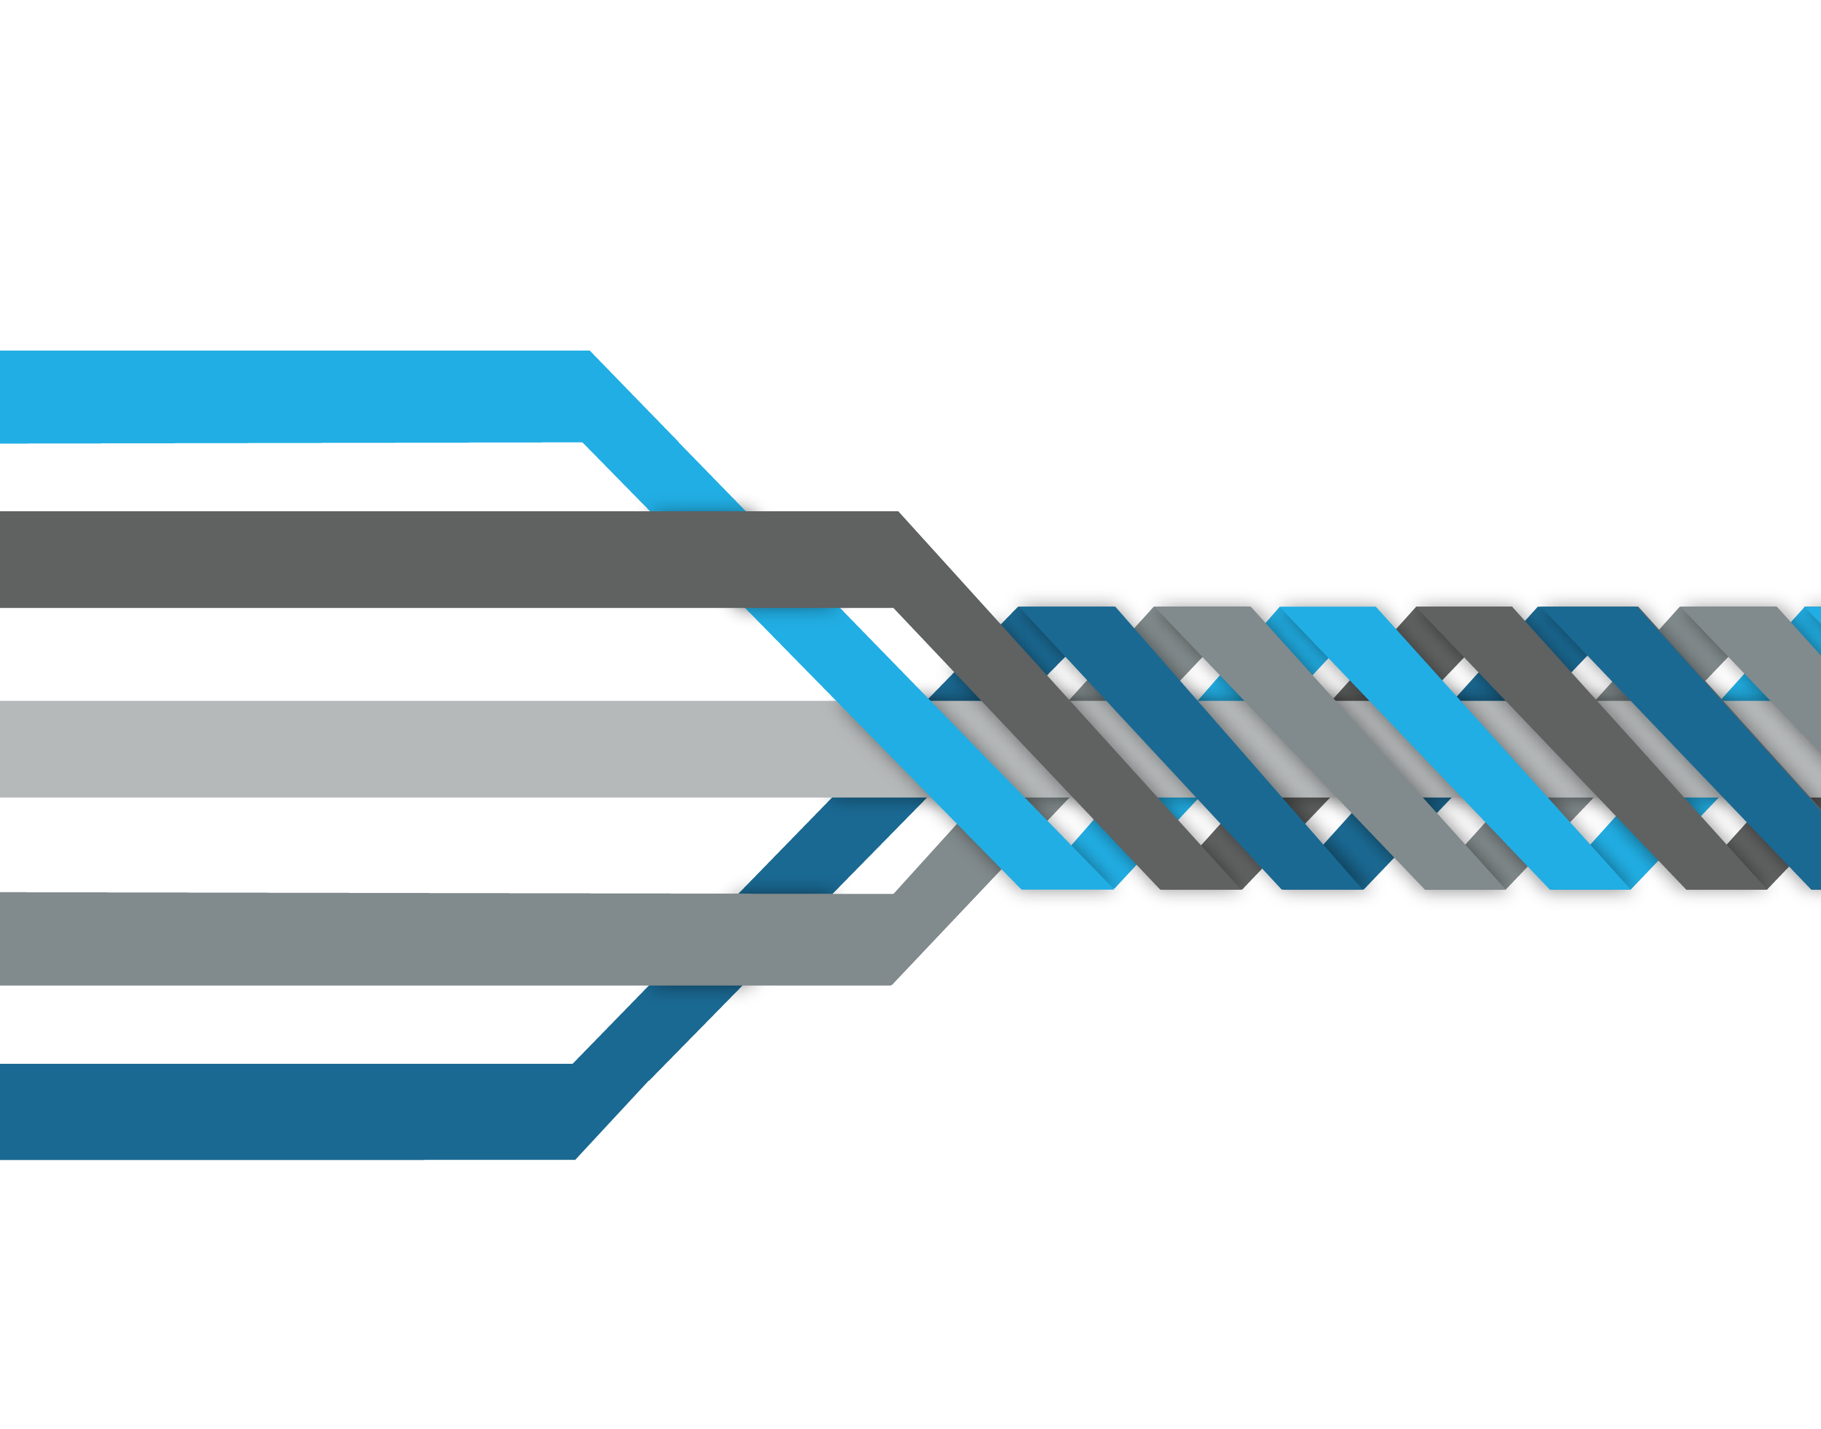
Our Unique Value Is in the Stitching
Integration of ESM and cloud management
Public Cloud
Data Center
Integration of security and automation
Cloud Management
Security and Risk
Integration of Dev and Ops pipelines to speed delivery
DevOps
Notes:
So I would argue that the second part of our unique value is in our ability to help you with the stitching – the integration across the of enterprise cloud.
Let me give you some examples.
You won’t find many service firms who understand what it takes to implement ServiceNow, but also to manage a public cloud environment with that platform. We understand the integration between enterprise service management and enterprise cloud management.
You won’t find many niche security vendors who truly understand the world of infrastructure & ops. We understand both worlds – including where security and automation come together.
And you won’t find many companies who can align and integrate a company’s app dev pipelines with its infrastructure and ops pipelines. We understand both worlds – and that reflects some of the work we’re doing in places like RedBull.
So our unique value is not only in our breadth of experience across these threads – but in how we stitch them together.

Slide 8



AHEAD Labs and Briefing Center
Review and refine your technology roadmaps
Translate technologies into possible outcomes
Opportunities to dive deep into seventy enterprise cloud technologies
Select from 100 demonstrations in our Labs
Engage our experts who have more than 500 certifications from across AWS, AppD, Chef, Cisco, EMC, Microsoft, Nutanix, Puppet, ServiceNow, and VMware
Technical Briefings
Notes:
We also offer more technical briefings, drawing from a large catalog of topics.
This is more about getting hands-on with specific technologies in one of our Labs, or at minimum diving a bit deeper into a specific toolset or technology.
And I think you’ll find our engineers, backed by a lot of certifications and ongoing training, second to none.
So that’s what we do and the portfolio of services, including education and market intelligence, that we offer.

Slide 9
AHEAD Innovation Days
AWS – Automation, Security, and Governance

Slide 10
Agenda
Lab 1 – AWS CloudFormation Overview
Lab 2 – Infrastructure as Code – Operations
Lab 3 – Image Operations
Lab 4 – Governance – Automating Security
Lab 5 – Auto Scaling Workloads
Innovation Demo / Raffle
Account Cleanup (Homework)
Additional Education Labs (Homework)

Slide 11
Getting Started
You should have:
Lab Guide
Laptop
AWS Account and Login
Internet Access
AWS Promo Code
DISCLAIMER: AHEAD IS NOT RESPONSIBLE FOR ANY COSTS INCURRED DURING THIS TRAINING. PLEASE DELETE YOUR RESOURCES AT THE END OF THE COURSE.

Slide 12
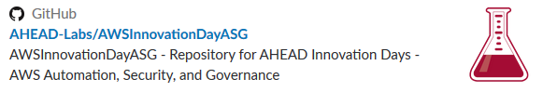
Accessing the Labs and Code
https://github.com/AHEAD-Labs/AWSInnovationDayASG

Slide 13

Bryan Krausen
Sr. Solutions Architect
Blog: itdiversified.com
Twitter: @btkrausen
Holds (6) AWS Certifications
Background in Data Center & Virtualization

Slide 14

Greg Thursam
Solutions Principal
Twitter: @gregthursam
Blog: Between2Clouds.blog
Holds (4) AWS Certifications
Background Cloud, D.C., and Linux

Slide 15

Eric Shanks
Senior Solutions Architect
Twitter: @eric_shanks
Blog: theITHollow.com
VCDX #195 DCV/CMA
Holds (5) AWS Certifications

Slide 16

Adam Youngblood
Cloud Technical Architect
Twitter: @automation_adam
Blog: CloudAutomation.blog
Holds (3) AWS Certifications

Slide 17
AHEAD Innovation Day
AWS CloudFormation

Slide 18
AWS CloudFormation
Often referred to as Infrastructure as Code
Describe and provision infrastructure and resources in AWS in code
‘Codify’ your environment
Create consistent, repeatable environments
Standardize environments across accounts, regions, or business units

Slide 19
AWS CloudFormation - Benefits
CloudFormation
Manual Deployment
Can be stored in source control for auditable change-log to infrastructure
Infrastructure can be easily recreated at any state
Combine with orchestration to enable automation patterns (CI/CD, rollback, blue-green, etc)
Best practices are embedded into the template
Requires third-party systems to monitor changes
Reverting infrastructure changes becomes detective work
Human error and drift are probable
Automating deployments is limited or requires complex coding

Slide 20
AWS CloudFormation - Template
Text file that can be written in YAML or JSON
Defines the resources to be provisioned in AWS
Resources can be in a single stack or use nested stacks
Manage relationships between created resources
Assign an EC2 instance to an Application Load Balancer
Create a Security Group and assign to an EC2 instance
Gather attributes from resources to apply to others
Deploy templates from the console, API, SDKs, or AWS CLI

Slide 21



AWS CloudFormation – Single Stack
User Request
Parameters
Outputs
VPC
Instances
Lambda
Single Stack
Network
NAT
SNS
AWS CloudFormation

Slide 22
AWS CloudFormation – Nested Stacks
User Request
Top Level Stack
Inputs
Outputs
Inputs
Outputs
Inputs
Outputs
VPC
Stack
Subnet
Stack
IAM
Stack
AWS CloudFormation

Slide 23
AWS CloudFormation - Parameters
Ability to pass values to your template upon creation or during updates
Define inputs to gather information from user
Parameter types include:
String
Number
List
Set default values for parameters
For sensitive parameters, use ‘NoEcho’ to obscure the entry
"Parameters" : {
"InstanceTypeParameter" : {
"Type" : "String",
"Default" : "t2.micro",
"AllowedValues" : ["t2.micro", "m1.small", "m1.large"],
"Description" : "Enter t2.micro, m1.small, or m1.large. "
}
}
CommaDelimitedList
AWS-Specific Type
SSM Parameter

Slide 24
AWS CloudFormation – Mappings
Match a key to a corresponding set of named values
Use Fn::FindInMap function to return a named value based on a specified key
Most often used with ‘Region’ selection for resources
Enables a template to be written without regard to a certain region
"Mappings" : {
"RegionMap" : {
"us-east-1" : { "32" : "ami-6411e20d", "64" : "ami-7a11e213" },
"us-west-1" : { "32" : "ami-c9c7978c", "64" : "ami-cfc7978a" },
}

Slide 25
AWS CloudFormation – Conditions
Define when a resource is created or when a property is defined
Ability to conditionally create resources
Combine with Parameters to determine what resources to build or how big to build them
Example: If deploying in Production, instance size is 5m.large. If dev, use t2.small.
"Conditions" : {
"CreateProdResources" : {"Fn::Equals" : [{"Ref" : "EnvType"}, "prod"]}
}

Slide 26
AWS CloudFormation – Resources
Declares the AWS resources that should be created
Only *Required section of a CloudFormation template
Resources are defined using a Logical ID and are used to reference other provisioned resources within the template
Each resource will declare a Resource Type (e.g., AWS::EC2::Instance)
Resources section makes use of all the other defined sections of the template (i.e., parameters, conditions, mappings, etc)

Slide 27
AWS CloudFormation – Outputs
Outputs are defined with a Logical ID followed by the desired value
Declares output values from resources created in template
Can be imported into other stacks, return in response (to describe stack calls, or viewed on the CloudFormation console.
Example: Output the S3 bucket name created in a stack to make it easier to find.

Slide 28
AWS CloudFormation – Pseudo Parameters
Used to return critical data within the Resources section
Parameters predefined by AWS CloudFormation
Examples:
AWS::AccountId – returns the account ID where the stack is created
AWS::Region – returns the region where the stack is being created
AWS::StackId – returns the ID of the CloudFormation stack

Slide 29
AWS CloudFormation – Intrinsic Functions
Built-in functions to help manage your stacks and resources
Used to assign values to properties that are not available until runtime
Examples:
Fn::FindInMap – returns a value corresponding to a map in Mapping section
Fn::GetAtt – returns the value of an attribute from a resource in the template
Fn:Join – appends a set of values into a single value
Ref – returns the value of a parameter or resource

Slide 30
AWS CloudFormation – Recommendations
Develop a library of CloudFormation templates that serve as the backbone for new infrastructure deployments. This enables you to ensure that best configuration and security practices are part of any new resource deployment, as those resource deployments are based off CloudFormation templates.
Build templates to be as parameterized and regionally abstract as possible, to maximize template reuse and enable multi-region deployments.
Store your CloudFormation templates in source control, and follow best practices for continuous integration and delivery when updating your templates.
Use a CI/CD (build/automation) server to orchestrate and automate the steps in your CloudFormation development pipeline (change → test -->delivery/deployment)
Generate change-sets for staging and production deployments, and analyze these change sets before running updates to stacks in these environments.

Slide 31
Lab 1 - CloudFormation
In this lab, participants will use CloudFormation to create the base infrastructure and additional AWS resources to use for subsequent labs. The lab will make use of nested CloudFormation templates to deploy the resources.

Slide 32
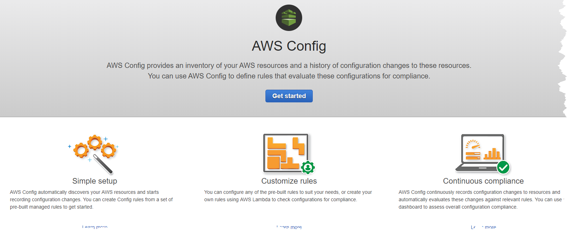
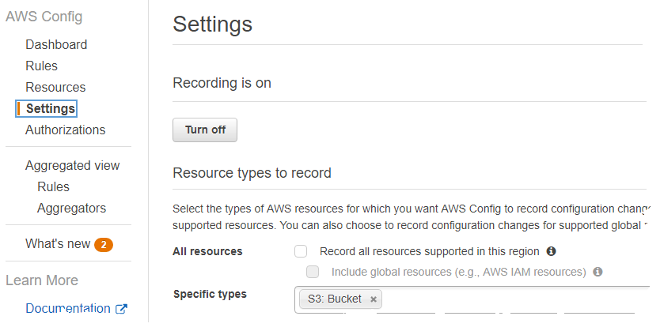
Lab 1 appendix
Config NOT in Use
Config in Use

Slide 33
AHEAD Innovation Day
AWS - Day 2 Operations

Slide 34
Day 2 - Operations
CloudFormation Update Stacks
CloudFormation: Coming Soon…..
Tagging Strategies
CloudWatch Overview
Configuration Management
Lambda as Operations
Real-World Examples
LAB TIME !

Slide 35


AWS CloudFormation – Updating a Stack
Updating a stack requires the creation and execution of a change set
Resources may require replacement
Update at the parent stack, not child stack
Deploy Stack
Create Change Set
Execute Change Set

Slide 36
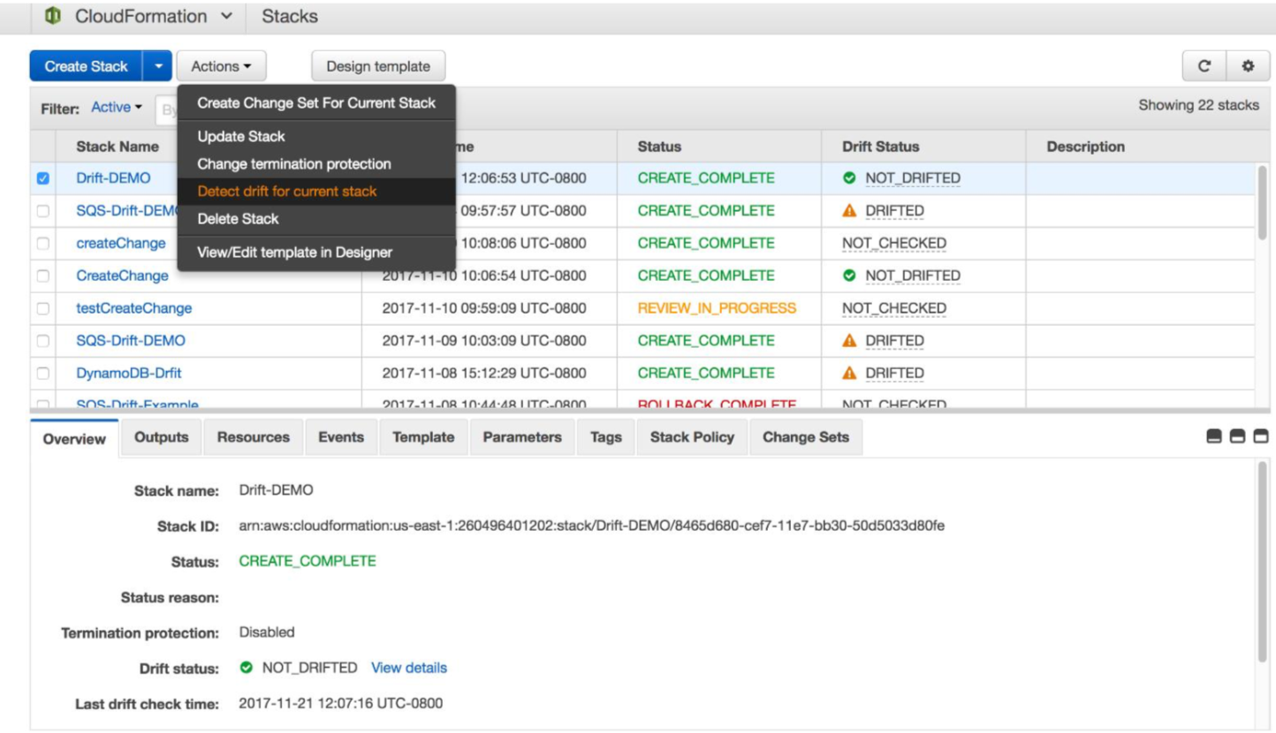
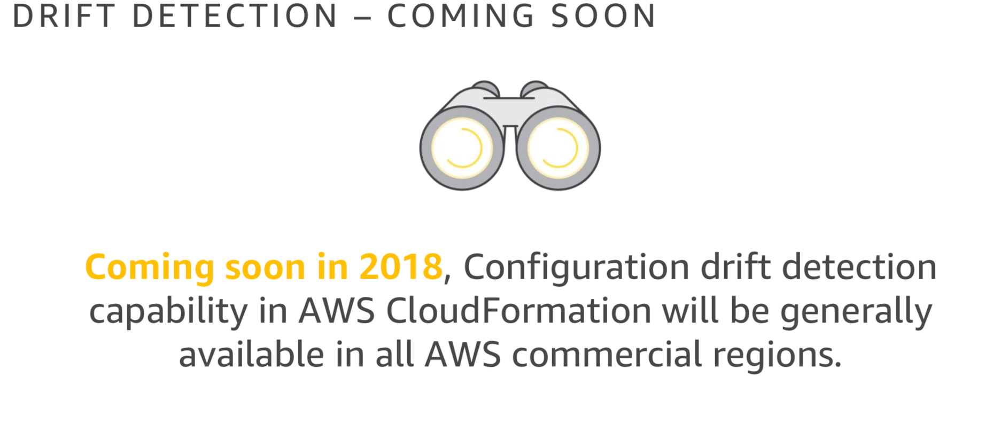
CloudFormation Drift Detection

Slide 37
AWS Tags
Tags
Use Benefits
Key Value Pairs
Key: Name
Value: John Smith
Metadata
Can be inherited
ASG, CFn, Beanstalk
Simplified organize method
Instant and automated real-time discover of resources
Can be used in IAM to automatically restrict permissions
For security you must then restrict who can set tags

Slide 38
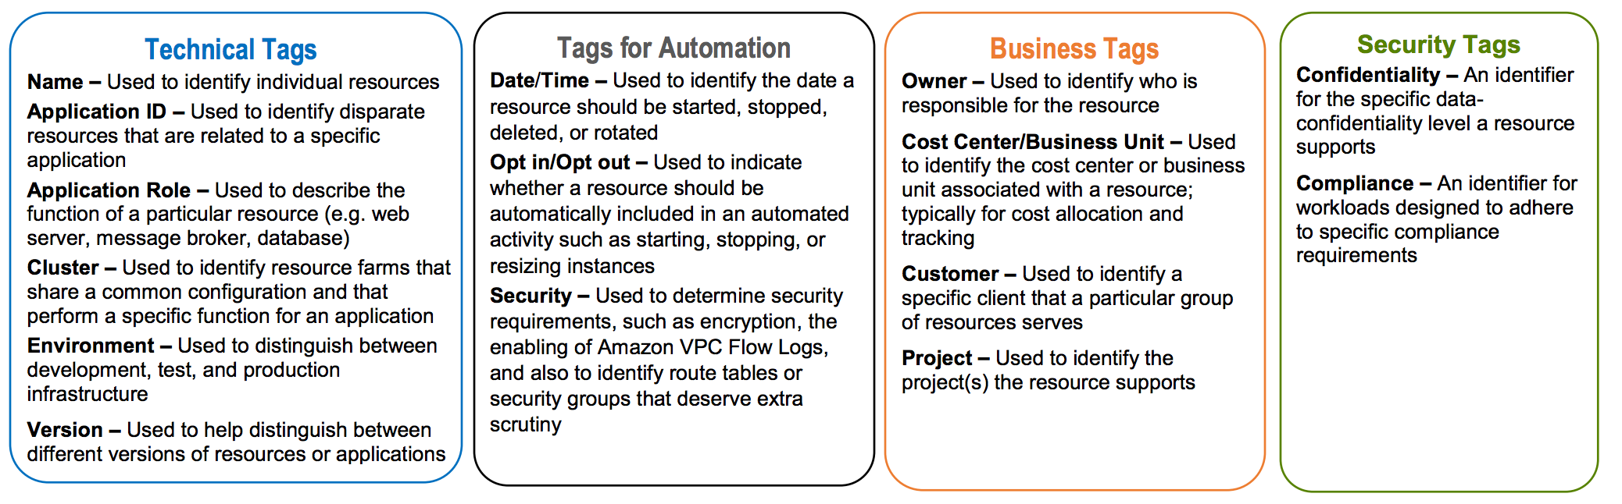
Tagging Categories

Slide 39
Tagging Design Best Practices/Guiding Principles
Tagging should represent organizationally relevant dimensions and adheres to tagging best practices:
Always use a standardized, case-sensitive format for tags, and implement it consistently across all resource types.
Consider tag dimensions that support the ability to manage resource access control, cost tracking, automation, security, and organization.
It is easy to modify tags to accommodate changing business requirements
Consider ramifications of future changes, especially in relation to tag-based access control, automation, or upstream billing reports.
Standardize, Communicate and Enforce
Err on the side of using too many tags rather than too few tags.

Slide 40


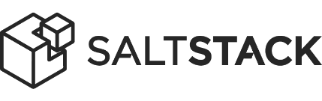

Configuration Management
OLD WAY
NEW WAY
Focus on pushing configuration to legacy systems in legacy ways (i.e. PowerShell, Shell scripting, etc.)
Focus on massive scale, new development, bridging legacy gap. Shifting mindset to engineering a desired state configuration.
AWS OpsWorks for Chef Automate
AWS OpsWorks for Puppet Enterprise

Slide 41
Configuration Management - Overview
Benefit
Use Cases
“Templatized” server configuration
Embed Security and Organizational Best Practice
Large OEM and Community Libraries
Standardize
Auditability
Avoid AMI sprawl
Auto Scaling servers
Self-Healing
Security / Compliance
Blue-Green, Zero-Downtime, and advanced automation patterns
Every EC2 use case!

Slide 42
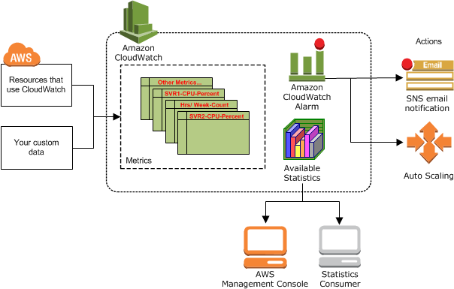
CloudWatch Overview
Amazon CloudWatch is a monitoring service for AWS cloud resources and the applications you run on AWS. You can use Amazon CloudWatch to collect and track metrics, collect and monitor log files, set alarms, and automatically react to changes in your AWS resources.

Slide 43



















Lambda as Operations
Function as a Service (FaaS)
Run code without provisioning or managing servers
Trigged from other AWS services (i.e. CloudWatch alarm) or schedule based
AWS Lambda is often used as the "engine" to run code or scripts in response to specific events
Health Events
Amazon CloudWatch
event (time-based)
Automated Action
AWS
Lambda

Slide 44
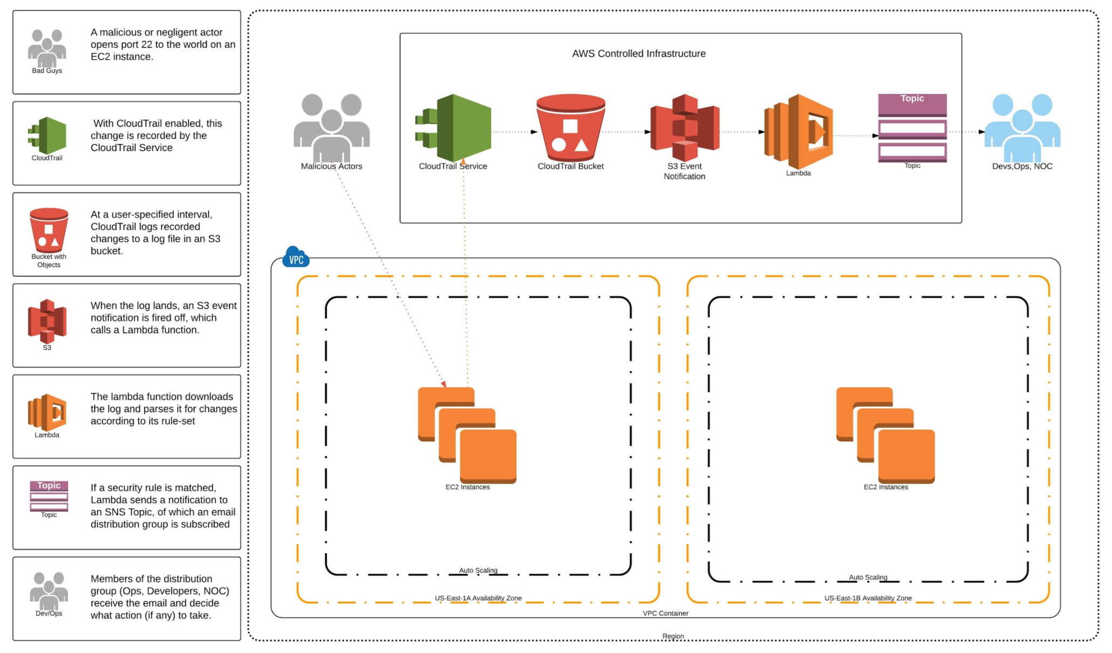
Example: Automating Events in AWS

Slide 45
LABLAB ACCOUNT Lab Account - Governance Update Governance Update
AWS Governance + Standards
EC2 SHUTDOWN
EBS LIFECYCLE & TERMINATION
Shutdown instances daily
TAG: AutoOff = True
Launches instances daily
TAG: AutoOn = True
Notify Owner
Snapshots EBS Volumes after 14 days of being available
Terminate EBS Volumes after 14 days of being available
Setup Lifecycle policy to glacier after 14 days
Terminate from Glacier after 14 days
Notify owner
1
2
TAG ENFORCER
EC2 LIFECYCLE & TERMINATION
Terminate instances immediately if missing required tags
TAGS: Name, Owner, ProjectID
Notify Owner
Terminate instances after 30 days of being stopped
Invoke ’EBS LIFECYCLE and TERMINATION’ function
TAG: DoNotDelete = False
Notify Owner
3
4

Slide 46
Lab 2 - Infrastructure as Code (Operations)
In this lab, participants will learn different techniques and use cases on how to manage changes to your automated AWS environment. Users will learn how to update existing stacks and add operational controls to the environment, such as data protection.

Slide 47
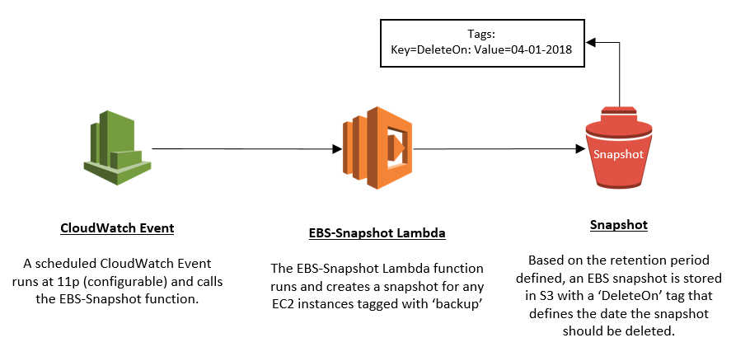
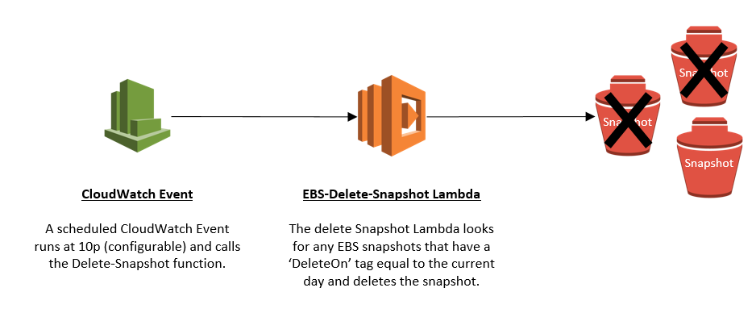
Lab 2 diagram
EBS-Snapshot-Create-Function
EBS-Snapshot-Delete-Function

Slide 48
AHEAD Innovation Day
Managing Compliance with AWS Systems Manager

Slide 49
AWS Systems Manager
Provides a list of capabilities including:
Run Command
State Manager
Patch Compliance
Maintenance Windows
Parameter Store
and more….

Slide 50

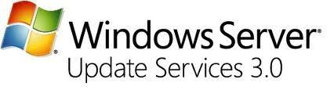

Relatable Services
AWS System Manager
Comparable Products
AWS Run Command
AWS Patch Manager
AWS Parameter Store

Slide 51
AWS Systems Manager
Some System Manager Services are used in the background
Patch Manager
Uses SSM Run Command to install and check for patches
Microsoft AD, AD Connector, Simple AD
Use Run Command to automatically join Windows Servers to the domain

Slide 52
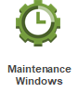

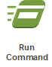

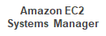
Combine System Manager Services
Multiple Services are often Chained Together
Lab 3 Example

Slide 53
AWS Systems Manager - Prerequisites
Requires an agent on any EC2 instance or managed instance running in a non-AWS environment
EC2 role with permissions to interact with the EC2 Systems Manager services
A PassRole policy to register tasks on your behalf.

Slide 54
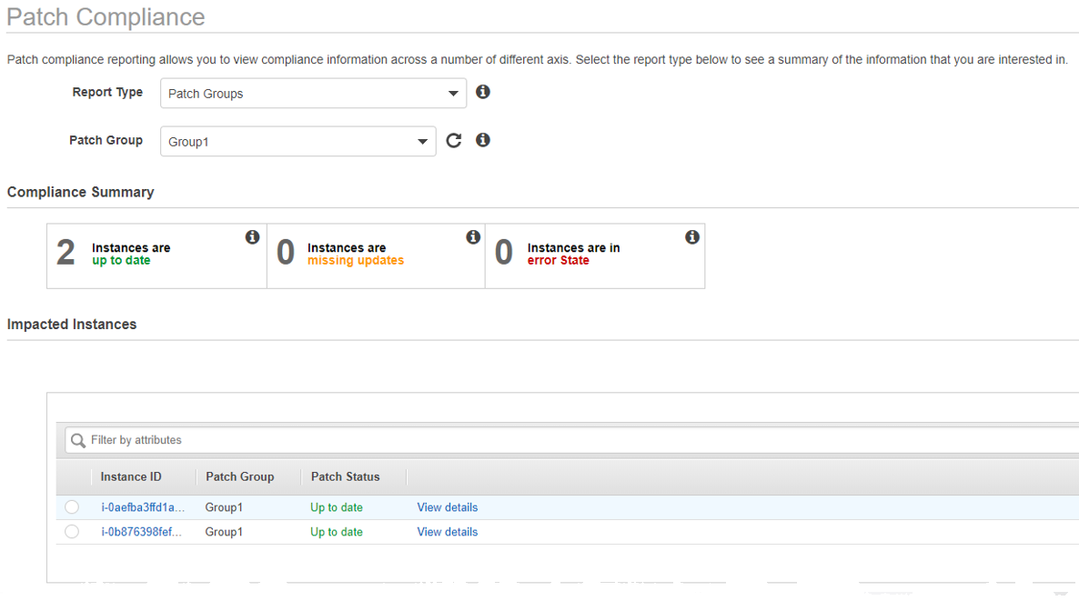
AWS Systems Manager – Patch Compliance
Built-in patching mechanism provided by AWS
Not as robust as SCCM or WSUS but effective...and free.

Slide 55
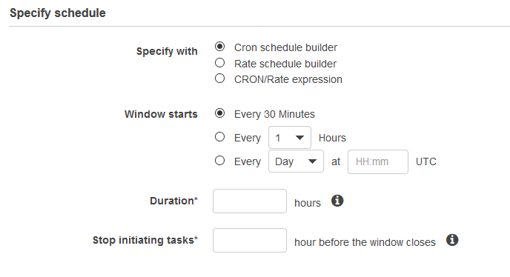
AWS Systems Manager – Maintenance Window

Slide 56
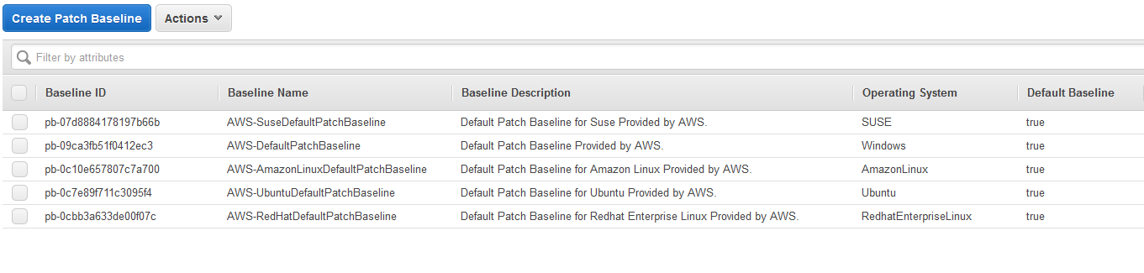
AWS Systems Manager – Patch Baselines
Pre-configured patch baselines for general defaults.
Custom patch baselines based on your own organizational policies

Slide 57
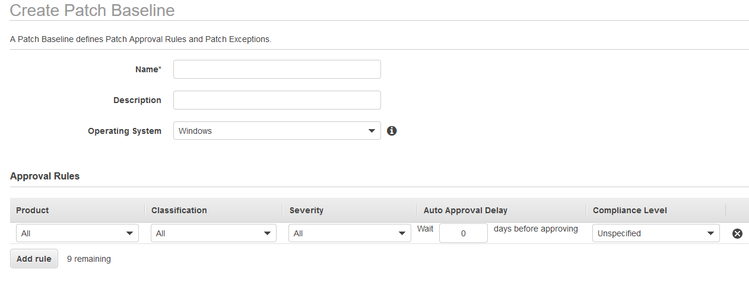
AWS Systems Manager – Custom Patches
Customize patches for the baseline, including selecting the OS, classification, severity, and product with auto approval delay options.

Slide 58
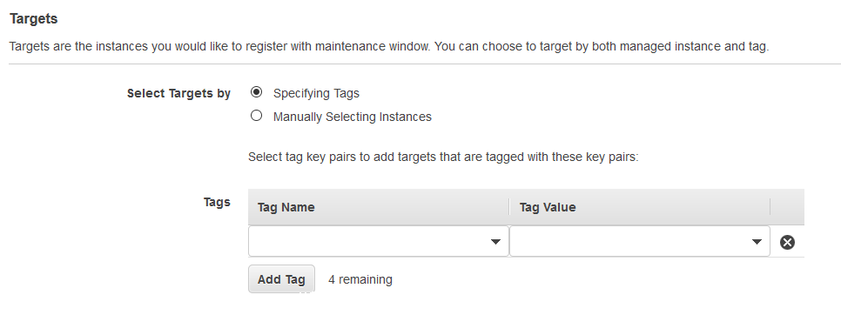
AWS Systems Manager – Target Groups
Group instances by Tags to configure different patching schedules for different environments, such as production, dev, and test.

Slide 59
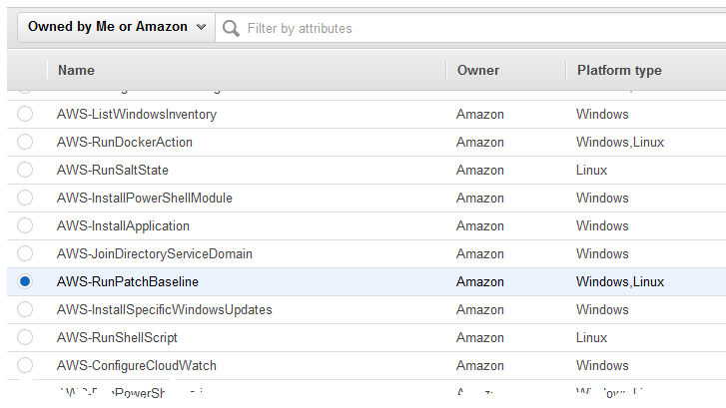
AWS Systems Manager – Run Command
Run Patch Baseline executes the patching mechanism on EC2 instances.
Baseline can either scan or scan & install.

Slide 60
Lab 3 – Image Operations
In this session, participants will learn how to use AWS native services for image patch management of EC2 instances. The lab will cover the integration of multiple services and how they work together to build a comprehensive operational strategy.

Slide 61
AHEAD Innovation Day
Automating Security with
AWS Config

Slide 62
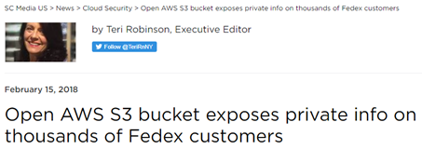
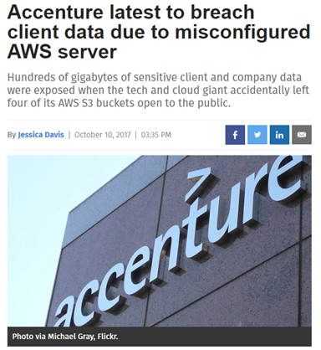
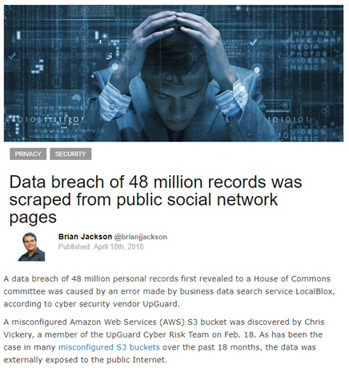
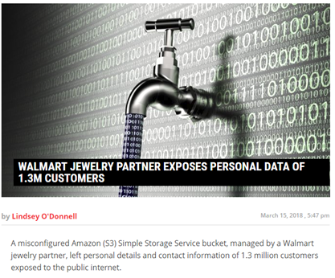
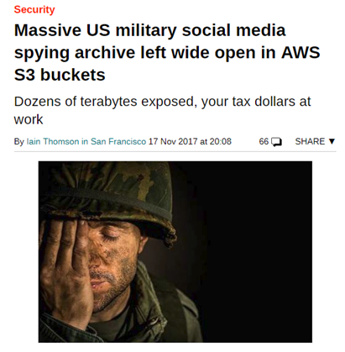
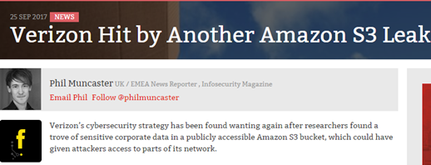
Breach!!!

Slide 63
AWS Config
Provides an inventory of AWS resources and a history of configuration changes to these resources
All configuration changes are recorded and stored on S3
Define Config rules to evaluate configurations to ensure compliance
Select from the pre-defined rules or customize your own to suit your needs.

Slide 64









Config Overview
AWS Config
AWS Resources
Config Rules
SNS Topic
SNS Subscribers
Notes:
AWS Config can monitor all or a subset of AWS Resources and records that data.
Config Rules can then be created to ensure the config matches desired state
Config Rules then stream that data to an SNS topic.
SNS topics can be subscribed to by users over email, or Lambda as examples.

Slide 65
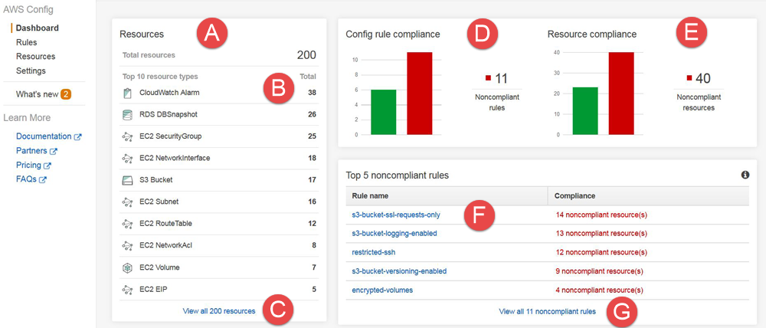
AWS Config Dashboard
Notes:
A – Total number of resources that config is recording
B – Resource types config is recording
C – View all Resources
D – View non-compliant rules
E – View non-compliant resources
F – View top non-compliant rules
G – View all non-compliant rules

Slide 66
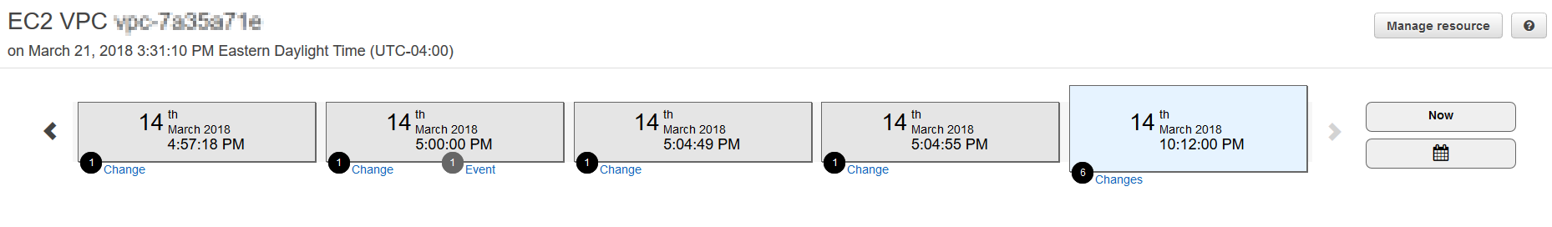
AWS Config – Change Tracking
Config continuously tracks changes throughout the AWS environment
Config can monitor a subset of specific AWS resources, such as S3 buckets or it can monitor the entire environment
Config can record changes from the environment in real-time, or periodically, such as once a day

Slide 67
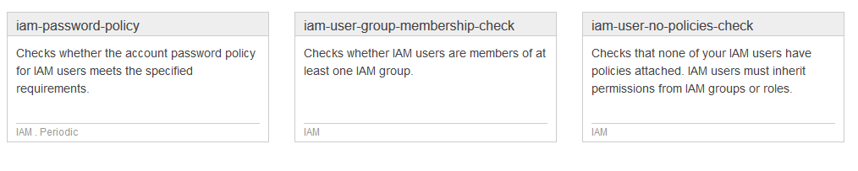
AWS Config – Config Rules
Managed Config Rules:
Managed by AWS and ready to immediately use
Custom Config Rules:
Lambda functions written by customers used to check and remediate any number of configurations deemed unwanted.

Slide 68
AWS Config – Config Remediation
AWS Config can not only record changes to the environment, but can take actions based upon undesired resources configurations.
Config stores log files in a specified S3 bucket but can also send changes to an Amazon Simple Notification Service (SNS) topic.
Subscribers to these SNS topics can be notified by email, or applications can be notified to take action.

Slide 69
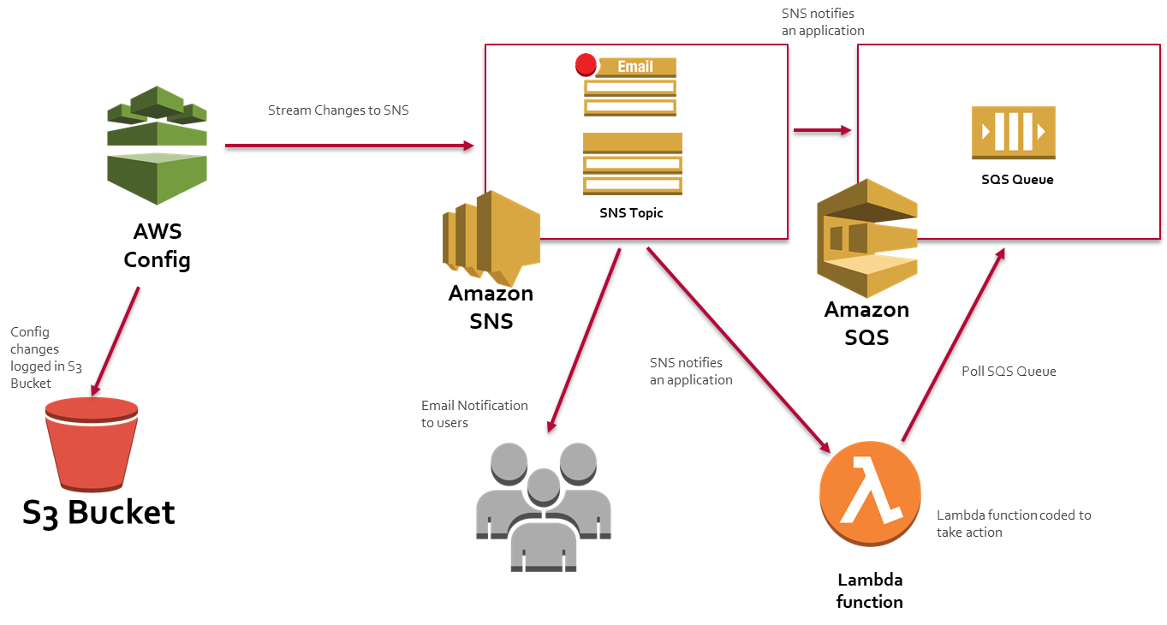
AWS Config - Actions

Slide 70
Lab 4 – Automating Security
In this lab, participants will learn how to automate the security and self-remediation of their AWS environments using AWS native tools. Using the combination of Config, SNS, and Lambda, users will ensure that their sensitive data stored in S3 remains private and out of the hands of unauthorized users.

Slide 71
AHEAD Innovation Day
Autoscaling Workloads on AWS

Slide 72
AWS Auto Scaling
Monitors applications and adjusts capacity to meet demands
Scale Up to meet demands, Scale Down to save costs
Will provide fault tolerance by replacing impaired instances
Dynamically scale or set a schedule for scaling activities
Define your own metrics to invoke a scaling event
Previously was limited to EC2 but has been expanded to ECS, DynamoDB, and Amazon Aurora

Slide 73
AWS Auto Scaling – Launch Configuration
Launch Configuration – template that an Auto Scaling group uses to launch EC2 instances.
AMI
Instance Type
Key Pair
Cannot modify a launch configuration
Must create a new launch configuration and modify ASG to point to new one
Security Groups
Block Device Mappings

Slide 74
AWS Auto Scaling – Auto Scaling Groups (ASG)
Collection of EC2 instances sharing similar functions
Treated as a logical group for scaling and management
A single application may have multiple ASGs (i.e., web tier, app tier)
Configuration items include:
Minimum Capacity
Maximum Capacity
Desired Capacity
Network Configuration
Scaling Rules
Notifications
Load Balancing

Slide 75
AWS Auto Scaling – Scaling Workloads
Scaling means an increase or decrease in resources
Three ways to configure scaling for your applications
Manual - modifications in the console)
Scheduled – if application has predictable traffic patterns
Dynamic – scale based on EC2 instance or application metrics
Should have a minimum of two scaling policies for each ASG
Scale Out – Adding Resources to handle workloads
Scale In – Remove Resources to save costs

Slide 76
AWS Auto Scaling – Scaling Policies
Can use CloudWatch metrics to trigger scaling event
CPU Utilization
Number of Connections to Load Balancer
Custom application metrics (customer created)
Can use SQS to trigger scaling as well
Example - if messages in queue > 100, add capacity

Slide 77
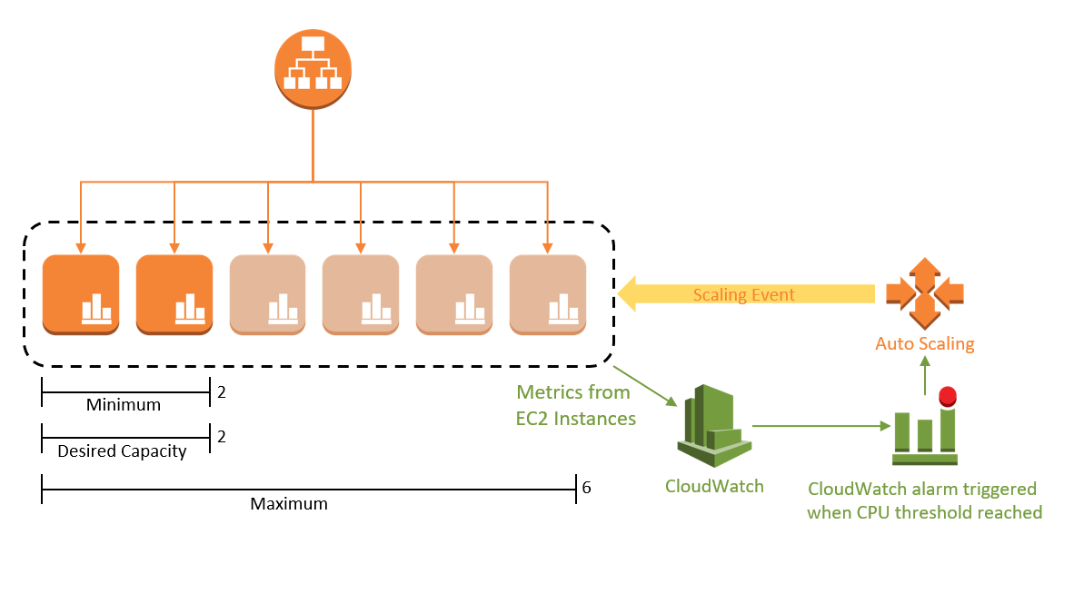
AWS Auto-Scaling

Slide 78











AHEAD Cloud Delivery Framework
Below are the areas that will be architected and deployed as part of AHEAD foundation or enterprise public cloud environment.
Education
Accounts and Structure
Network Design
EC2 Instances
Storage
Application Architecture
Identity Management
Platform Security
Governance
Operations and Monitoring
Systems Management and Automation
Inventory, Cost, and Security Optimization
Operations Framework

Slide 79







AHEAD Well-Architected Framework
The Well-Architected Framework is designed to provide you with high-level guidance and best practices, not an audit, to help you build and maintain secure, reliable, performant, cost optimized, and operationally excellent applications in the Cloud.
Operational Excellence
Security
Reliability
Performance
Efficiency
Cost Optimization
Free $5,000 in AWS Credits to Remediate Gaps

Slide 80
AHEAD Cloud Delivery Framework
Below are the areas that will be architected and deployed as part of AHEAD foundation or enterprise public cloud environment.
Education
Accounts and Structure
Network Design
EC2 Instances
Storage
Application Architecture
Identity Management
Platform Security
Governance
Operations and Monitoring
Systems Management and Automation
Inventory, Cost, and Security Optimization
Operations Framework

Slide 81
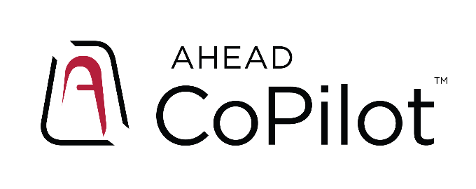



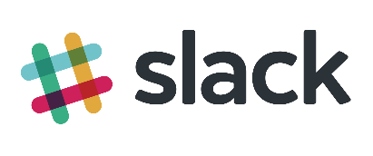






for AWS
Inventory, Cost, Security & Compliance Monitoring
CoPilot Message Processor
Incident Management & CoPilot Cloud Insight
Security Monitoring
Cost
Management
Malware
Detection
Desired State
Configuration
Vulnerability
Scanning
Performance Alerts and Monitoring
DLP and Data
Classification
Behavior and
Network Analytics
Service
.Next
Processing,
Consolidation,
and Deduplication
Notes:
Now, let’s take a look at the tools that are driving the service. Under Inventory, Cost, Security, and Compliance monitoring, we have two groups of tools.
The top group is the third-party and open source tooling that is integrated into the service.
The bottom group includes AWS native services.
All of these tools feed into the message processor, and eventually ServiceNow.
After processing, a ticket is created for customers to review the information, allowing for them to derive meaningful insight from the sources of the information.

Slide 82


for AWS
Inventory, Cost, Security & Compliance Monitoring
CoPilot Message Processor
Incident Management & CoPilot Cloud Insight
Security Monitoring
Cost
Management
Malware
Detection
AWS Config
Amazon Inspector
Amazon CloudWatch
AWS Macie
Amazon GuardDuty
Message Processor
Notes:
Now, let’s take a look at the tools that are driving the service. Under Inventory, Cost, Security, and Compliance monitoring, we have two groups of tools.
The top group is the third-party and open source tooling that is integrated into the service.
The bottom group includes AWS native services.
All of these tools feed into the message processor, and eventually ServiceNow.
After processing, a ticket is created for customers to review the information, allowing for them to derive meaningful insight from the sources of the information.

Slide 83

DevOps Innovation Days
CI / CD Pipeline
Enterprise DevOps ToolChain
SDLC and GitFlow Practices
Serverless and Kubernettes
Deployment Methods
What do YOU want to see?

Slide 84





Raffle Architecture
Alexa Skill
AWS
Lambda
Amazon DynamoDB

Slide 85
Thank You
Notes:
So thanks for your time, and I like forward to an opportunity to partner with you.

